Slide 1
Seattle Road Accident
IBM Data Science Capstone

Slide 2
Introduction
Seattle is a seaport city on the West Coast of the United States. Seattle is the largest city in both the state of Washington and the Pacific Northwest region of North America. According to U.S. Census data released in 2019, the Seattle metropolitan area's population stands at 3.98 million, making it the 15th-largest in the United States.
As the residents get around by cars the accidents are increasing day by day.
To reduce the accidents a machine learning model should be build to alert the driver early respective to the weather road condition.
Predicting the chance of accident help the driver to drive car carefully.

Slide 3
Data Acquisition and Cleaning
Data link: https://s3.us.cloud-object-storage.appdomain.cloud/cf-courses-data/CognitiveClass/DP0701EN/version-2/Data-Collisions.csv
There are total 194673 rows and 38 features in the raw dataset.
Unnecessary features are dropped
Cleaned data contains 189337 rows and 6 features .

Slide 4
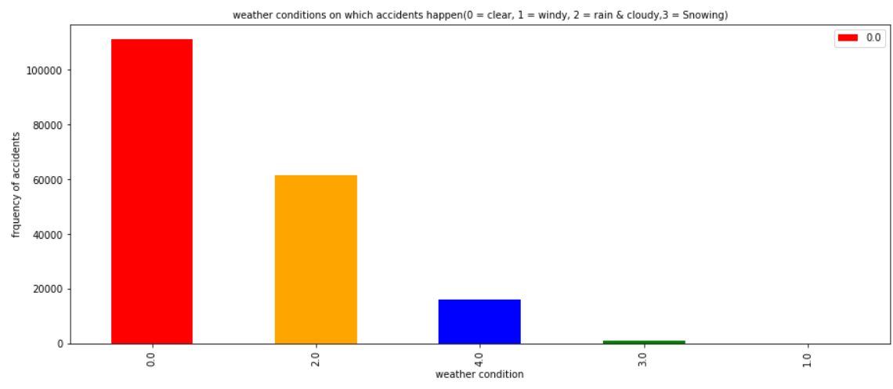
Impact of Weather on Accidents

Slide 5
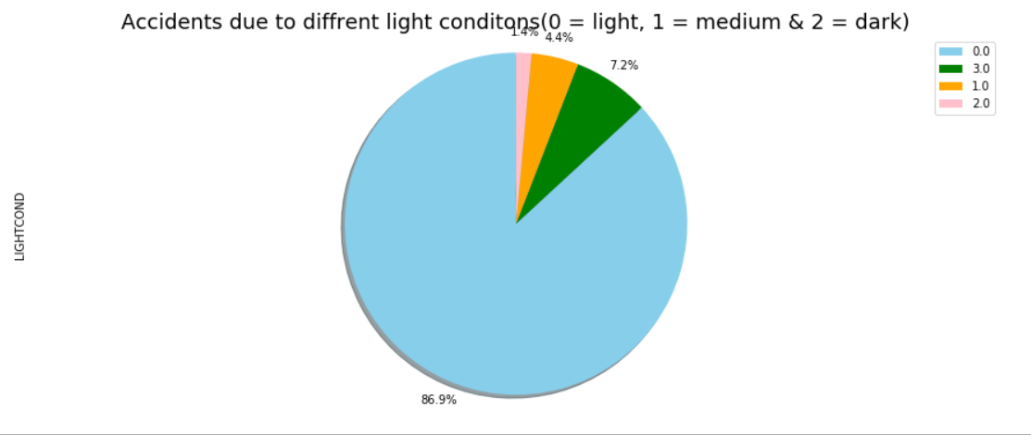
Impact of light on Accidents

Slide 6
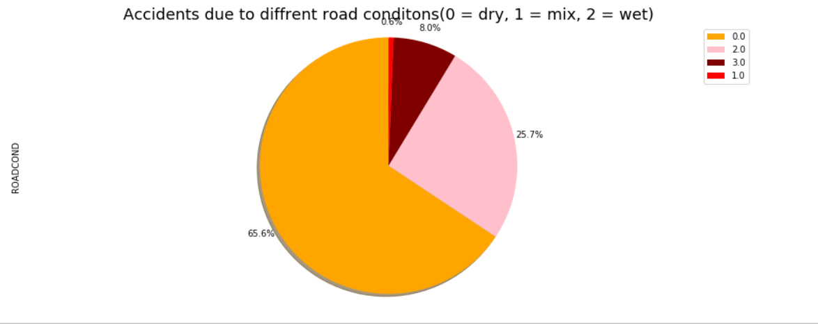
Impact of Road on Accidents

Slide 7
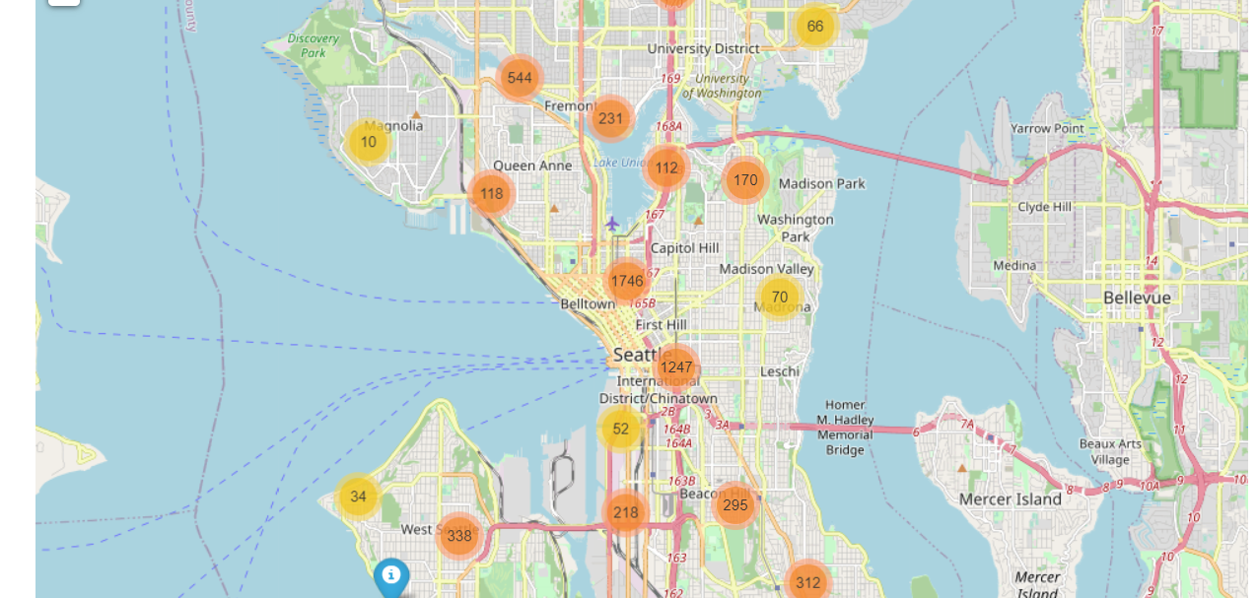
Place of Accidents

Slide 8
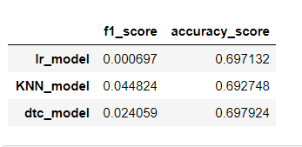
F1_score and Accuracy score of models

Slide 9
Result & Conclusion
Built a models which can predict the chance of Accidents and alert the driver.
Based on analysis performed on data, weather conditions have a somewhat impact on accidents. The more accidents happened in clear weather. So we can conclude that the driver has to be more careful while driving on a clear day otherwise it can result in property damage and injury damage.

